Slide 1

Data ELT Pipeline: Unlocking the Power of Data
Presented By:
Anton Jesu Vikranth

Slide 2

Understanding the ELT Process
Extract
The ELT process begins with extracting data from various sources, such as databases, APIs, and files, into a staging area.
Load
Once extracted, the raw data is loaded into a data warehouse or lake, creating a central repository for your data.
Transform
Finally, the data undergoes transformation, which includes cleaning, standardizing, and preparing it for analysis and reporting.

Slide 3

Identifying Data Sources
Data Sources
APIs
Integrated with external APIs to pull data online services.
Used Job Search API
https://www.themuse.com/developers/api/v2
Static Datasets
https://jobdatafeeds.com/job-data-overview

Slide 4
Data: Job posting and Historic Job posting
API endpoint: GET https://www.themuse.com/api/public/jobs
Static Dataset: https://jobdatafeeds.com/job-data-overview
Techmap provides access to millions of global job postings since 2020, available in JSON format.
Job Posting Datafeeds: Subscribers receive daily country-specific job postings for continuous analytics.
Job Posting Datasets: Historical job data (since 2020) can be purchased for large-scale analysis.
Job Postings API: Offers real-time and historical data for detailed job data utilization.

Slide 5

Selecting the Right Data Warehouse
Scalability: BigQuery is a fully managed, serverless data warehouse that scales automatically, handling both small and very large datasets efficiently.
Performance: Optimized for high-performance SQL queries on large datasets, using a columnar storage format and BigQuery’s Dremel technology.
Integration with GCP: Native integration with other Google Cloud services, allowing seamless data flow from Google Cloud Storage to BigQuery.
Cost Efficiency: Supports a pay-as-you-go model, charging only for the storage and the data processed during queries, making it cost-effective.
Security and Compliance: Offers strong security features, including encryption at rest and in transit, plus compliance with major data regulations.

Slide 6

Selecting the right Data Transformation Tool
Modular Transformations: dbt structures SQL-based transformations in a modular way, making code reusable and maintainable.
Version Control and Collaboration: dbt integrates well with version control tools like Git, promoting collaborative development and enabling rollbacks.
Testing and Validation: Built-in testing capabilities allow for automated data checks, ensuring data quality across transformations.
Efficient for SQL-based Transformations: Allows the data transformation logic to live in BigQuery, reducing the need for complex ETL workflows and leveraging SQL.
Open-source and Community Support: Strong community and extensive documentation support for dbt make it easy to learn and adopt best practices.

Slide 7

Data Cleaning
Datatype Conversion
Removing HTML characters
Imputed Null Values Appropriately
Removing unnecessary characters

Slide 8
Implementing Robust Data Transformations
1 Project
2 Models – Historic and Daily Job Postings
Daily - Incremental Materialization, Data Extraction with UNNEST, Field Selection and Renaming, Incremental Data Filtering
Historic – Materialization, Union of Multiple Sources, Field Selection and Renaming, Timestamp Conversion, Row Numbering, Unnesting of Array Fields, Left Join with Default Values

Slide 9

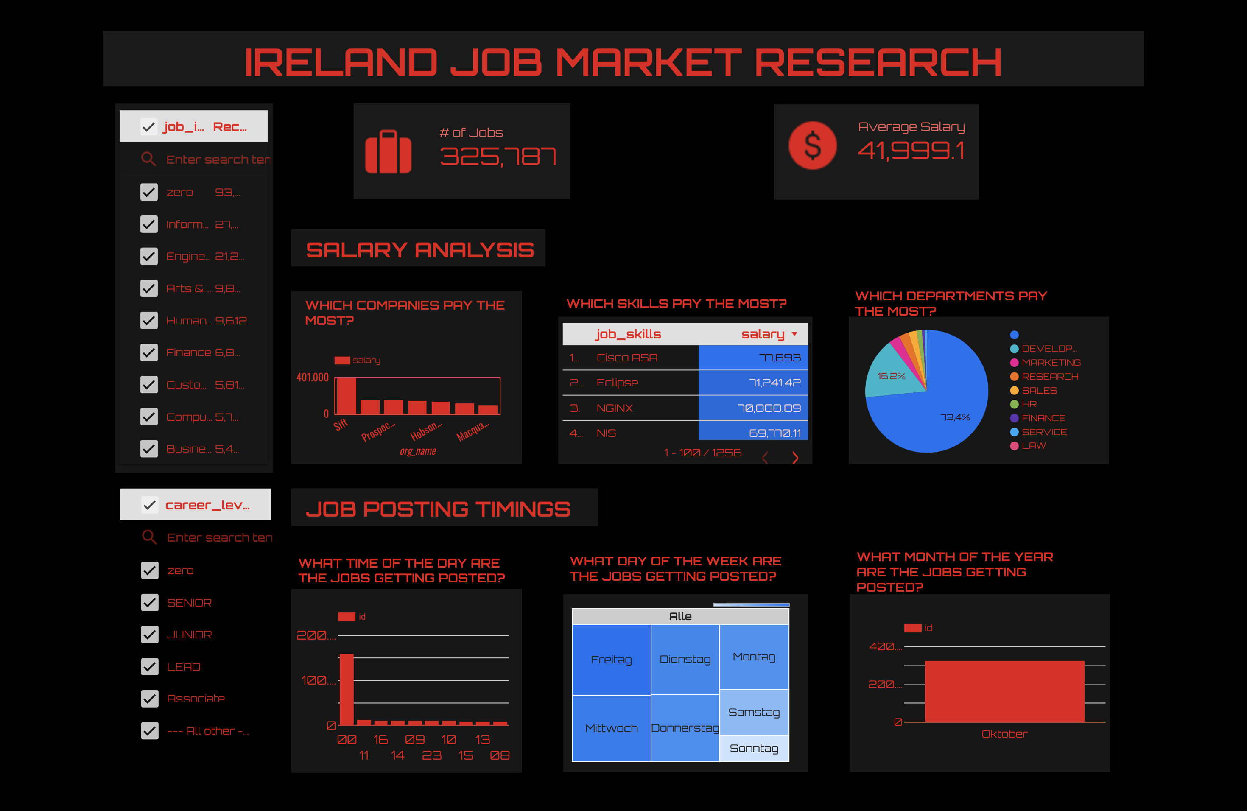
Visualizing the data - Looker

Slide 10

Automating the ELT Pipeline
1
Scheduling
2
Data Orchestration
Utilize orchestration tools to manage and coordinate different data processing tasks within the ELT pipeline.
3
Error Handling
Implement robust error handling mechanisms to detect and handle potential failures during the ELT process.
Set up automated schedules to initiate data extraction, loading, and transformation tasks at regular intervals.

Slide 11
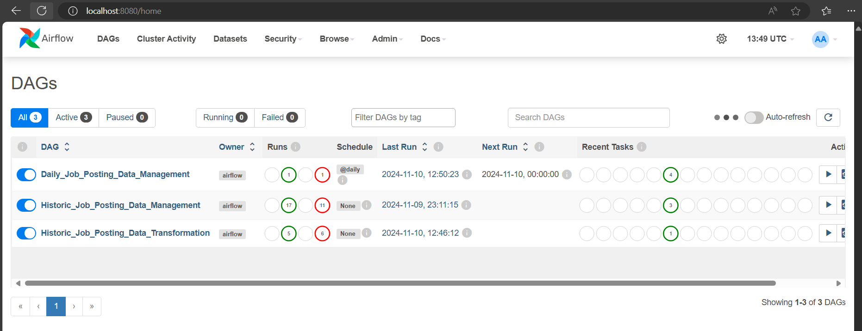
Airflow Jobs

Slide 12
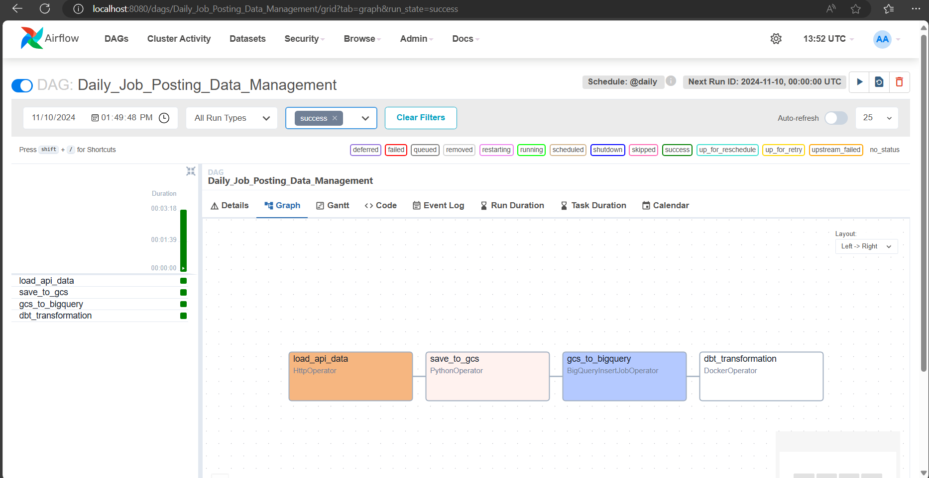
Airflow – Daily Job

Slide 13
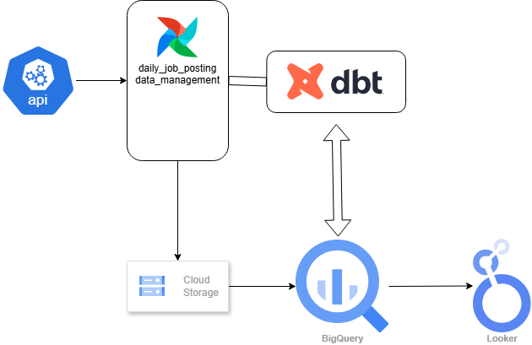
Airflow – Daily Job Pipeline Architecture

Slide 14
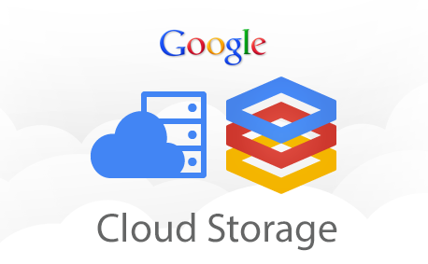
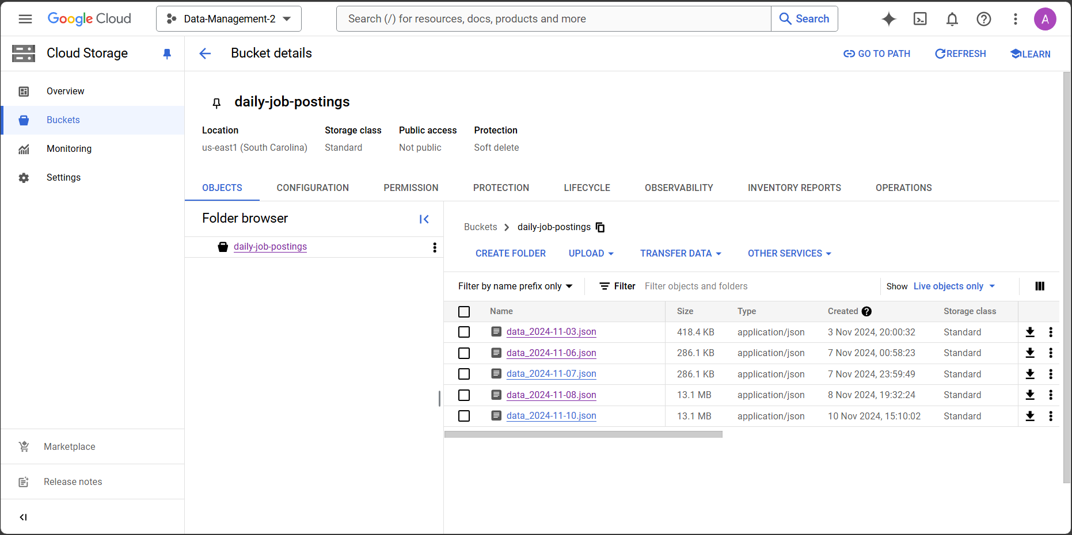
Bucket: Daily Job Posting Data Extraction

Slide 15
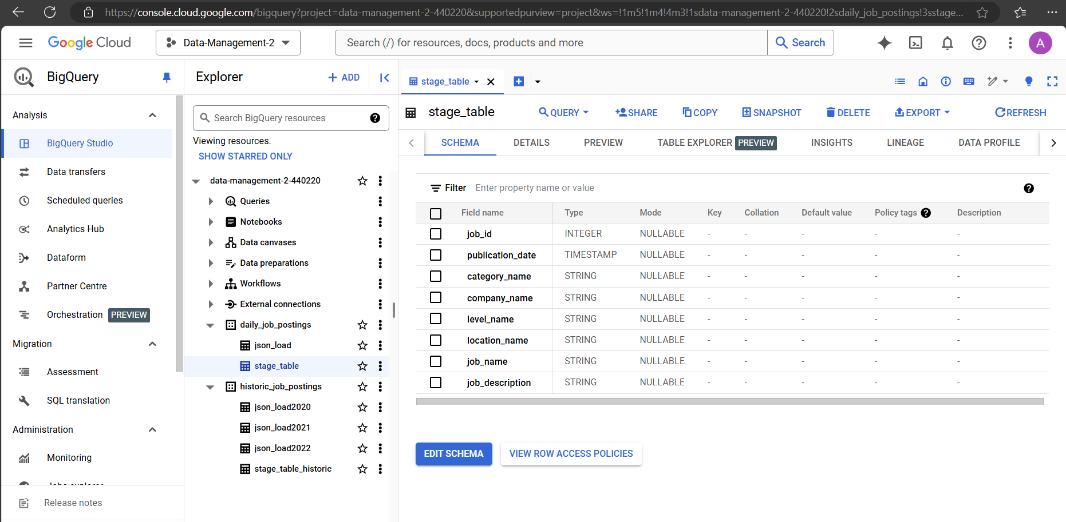
Dataset: Daily Job Posting

Slide 16
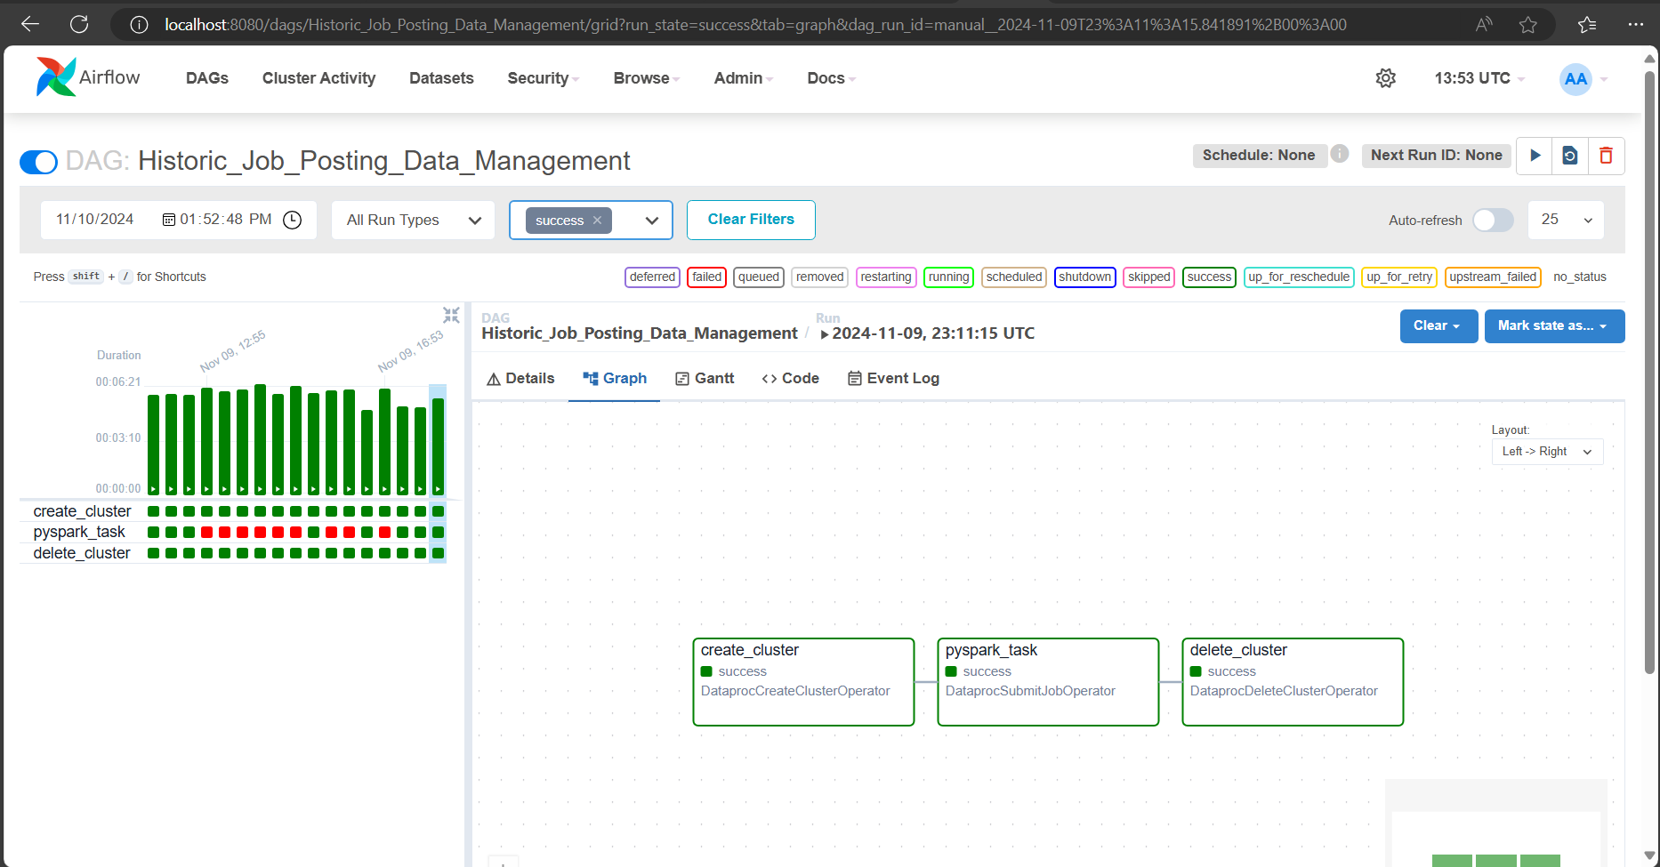
Airflow Job Run

Slide 17
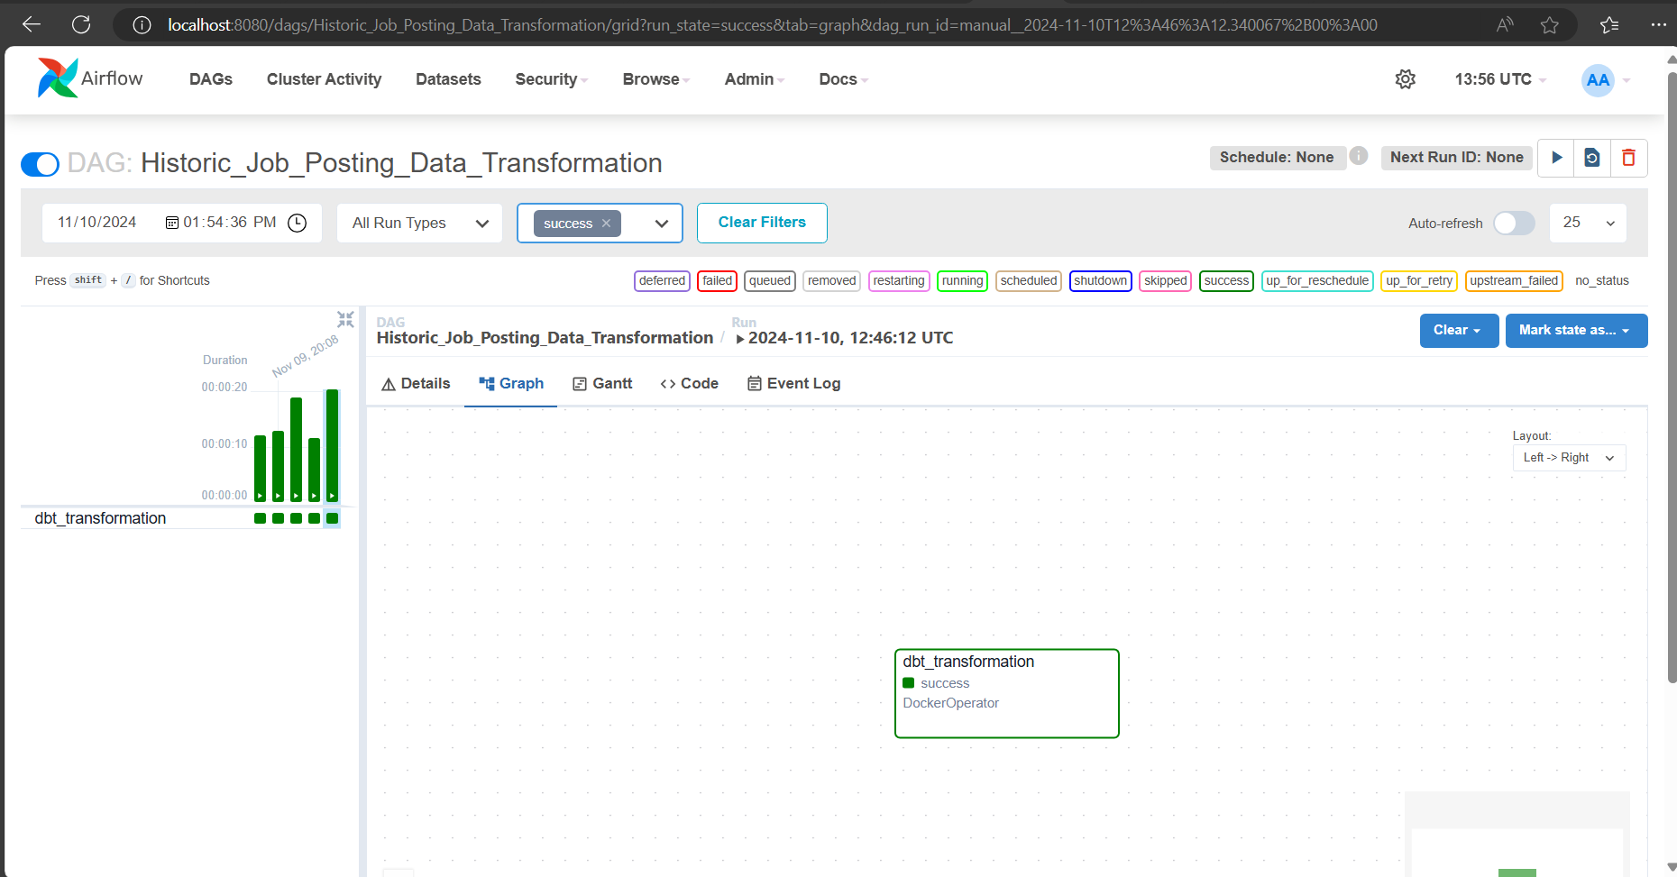
Airflow Historic Job run

Slide 18
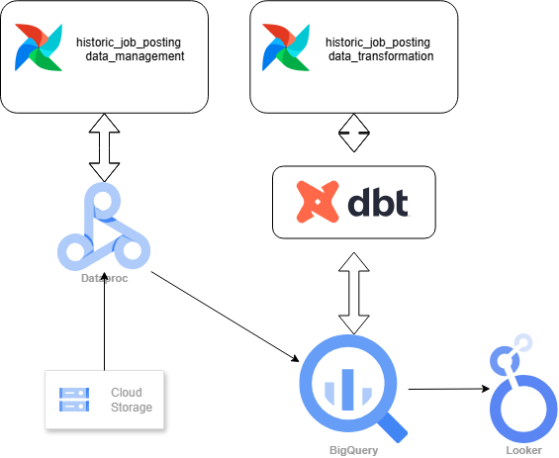
Airflow – Historic Job Pipeline Architecture

Slide 19
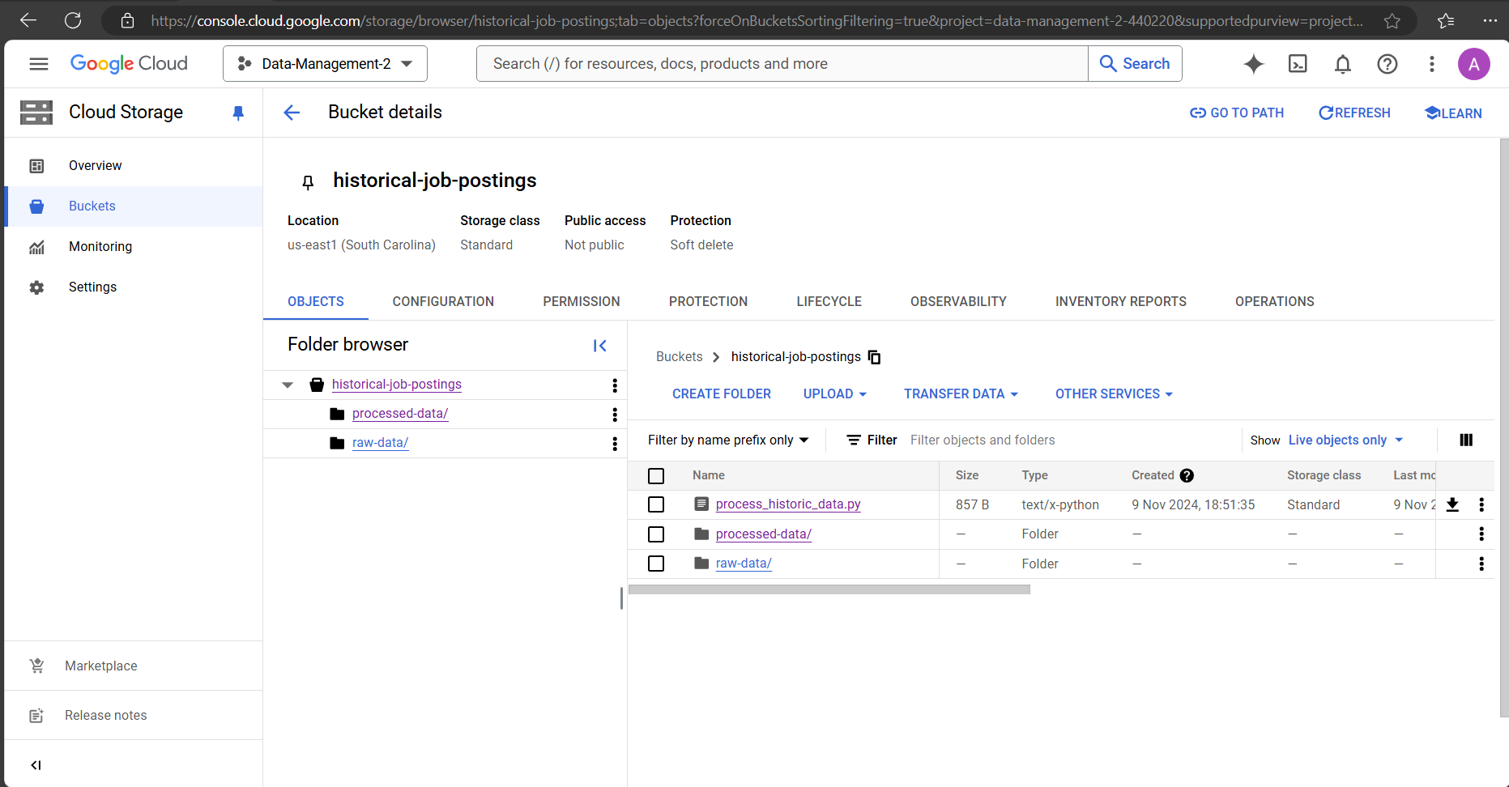
Bucket: Historic Job Posting Data Extraction

Slide 20
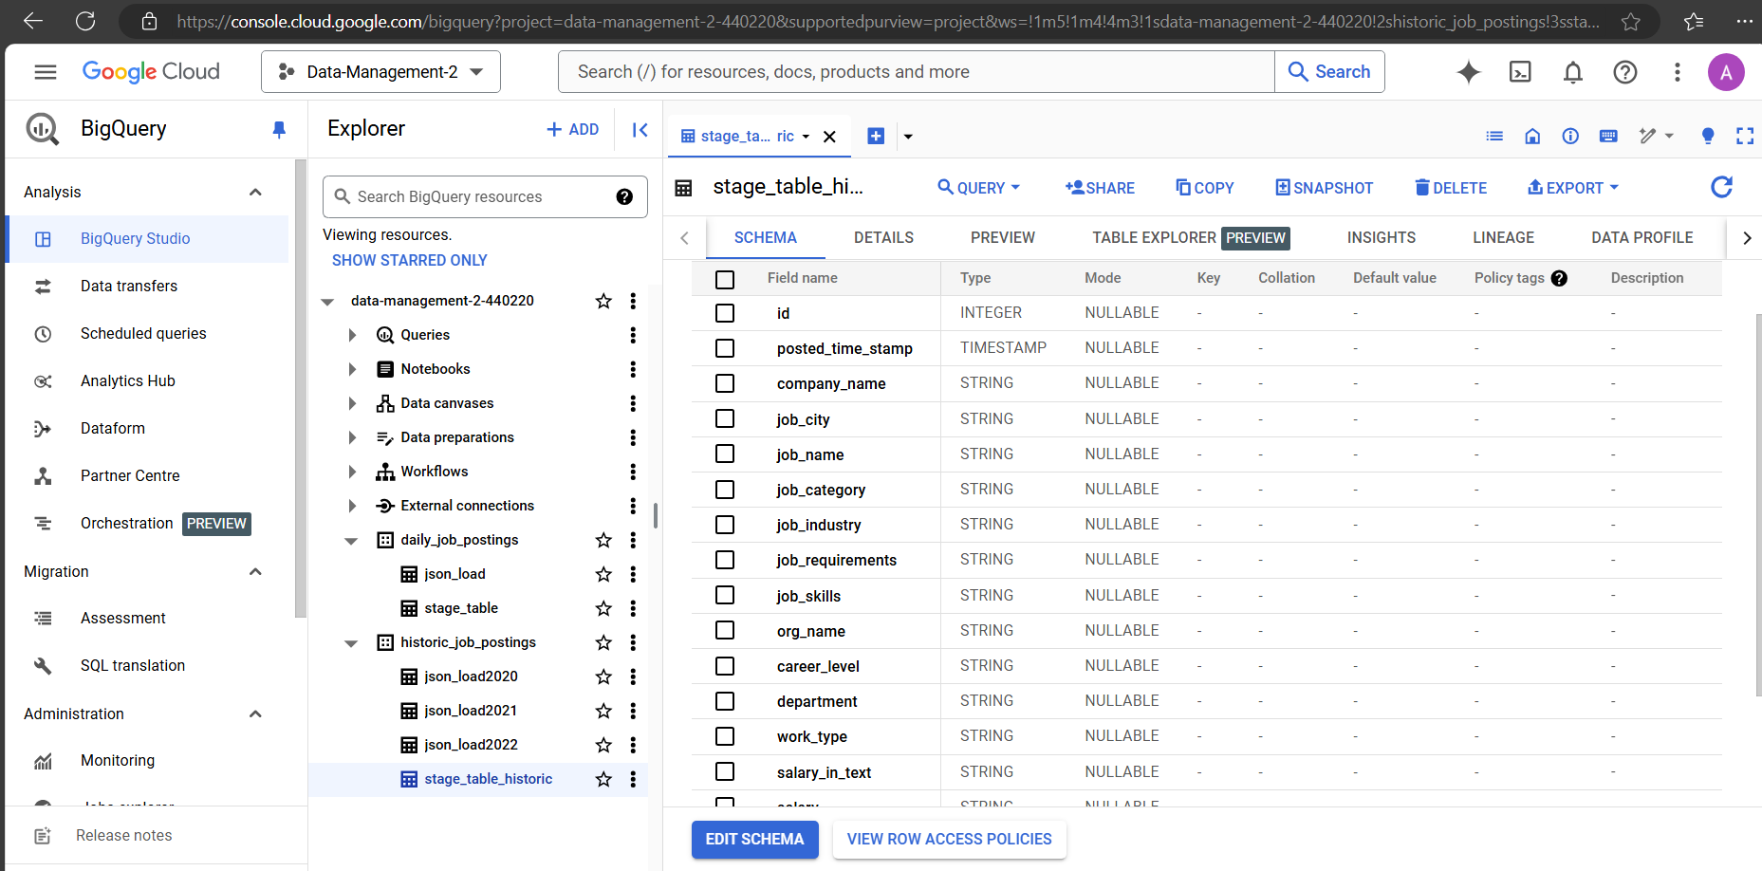
Dataset : Historic Job Posting

Slide 21

Goals & Outcomes
Goals
Automate Data Workflow
Scalable Data Transformation
Accessible Data Insights
Leverage Cloud Resources
Reusable Data Pipeline
Outcome: Project achieves a fully automated and cloud-based ELT pipeline

Slide 22

GitHub
https://github.com/ajvikranth/Data-Management-2/tree/master

